Slide 1

Azure API Management
Jaikrishnan Pandurangan
Architect

Slide 2
Azure API Management
Azure API Management is a cloud service that gives you a platform for publishing, securing, maintaining, and analyzing all your company's APIs.
Notes:
​

Slide 3
API Management Components
API gateway
Management plane
Developer portal
Notes:
The API Management gateway (also called data plane or runtime) is the service component that's responsible for proxying API requests, applying policies, and collecting telemetry.
​The API gateway is the endpoint that:
Accepts API calls and routes them to appropriate backends
Verifies API keys and other credentials presented with requests
Enforces usage quotas and rate limits
Transforms requests and responses specified in policy statements
Caches responses to improve response latency and minimize the load on backend services
Emits logs, metrics, and traces for monitoring, reporting, and troubleshooting
The management plane is the administrative interface where you set up your API program. Use it to:
Provision and configure API Management service settings
Define or import API schema
Package APIs into products
Set up policies like quotas or transformations on the APIs
Get insights from analytics
Manage users
The Developer portal is an automatically generated, fully customizable website with the documentation of your APIs. Using the developer portal, developers can:
Read API documentation
Call an API via the interactive console
Create an account and subscribe to get API keys
Access analytics on their own usage
Download API definitions
Manage API keys

Slide 4
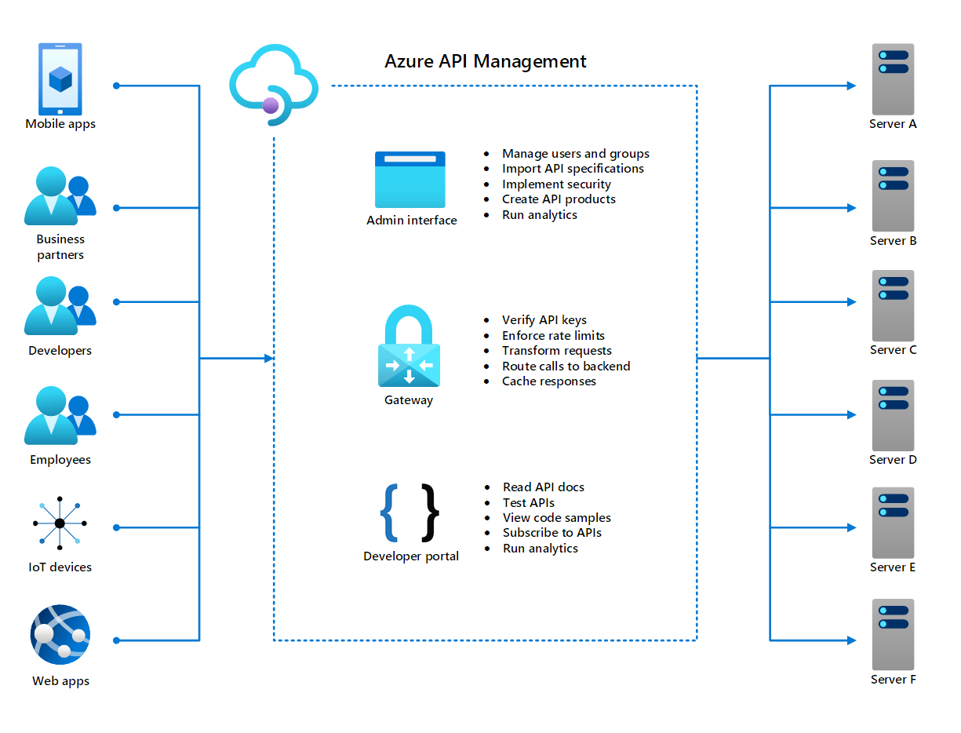
https://docs.microsoft.com/en-us/learn/modules/introduction-to-azure-api-management/2-what-is-azure-api-management

Slide 5
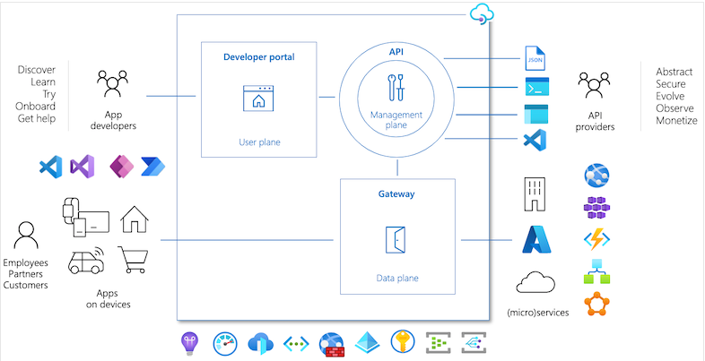
https://learn.microsoft.com/en-us/azure/api-management/api-management-key-concepts

Slide 6
Self-hosted Gateway
Allows API traffic to flow directly to the backend APIs, which reduces latency, optimizes data transfer costs, and enables compliance while retaining the benefits of having a single point of management, observability, and discovery of all APIs within the organization regardless of where their implementations are hosted.
Cons: some functionality found in the managed gateways is not available in the self-hosted gateways. Require outbound TCP/IP connectivity to Azure on port 443
Notes:
​Azure Monitor logs
Upstream (backend side) TLS version and cipher management
Validation of server and client certificates using CA root certificates uploaded to API Management service. You can configure custom certificate authorities for your self-hosted gateways and client certificate validation policies to enforce them.
Integration with Service Fabric
TLS session resumption
Client certificate renegotiation. This means that for client certificate authentication to work, API consumers must present their certificates as part of the initial TLS handshake. To ensure this behavior, enable the Negotiate Client Certificate setting when configuring a self-hosted gateway custom hostname.
Built-in cache. Learn about using an external Redis-compatible cache in self-hosted gateways.

Slide 7
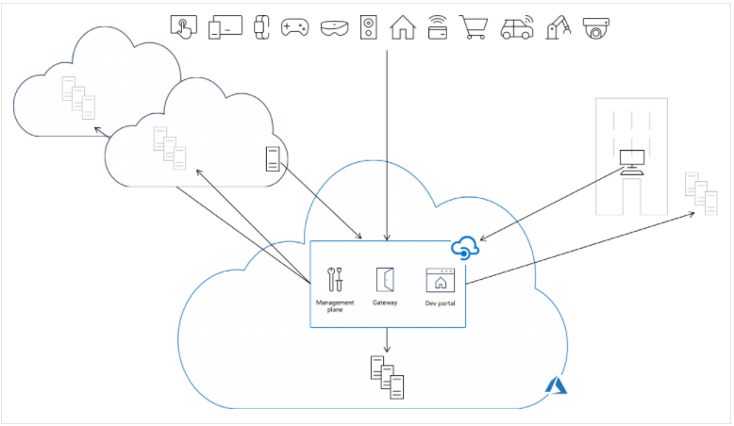
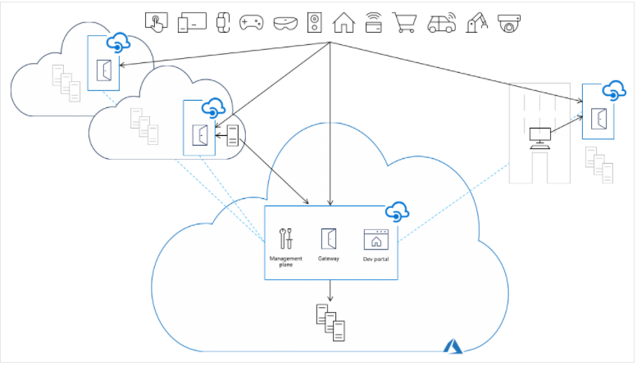
Azure Managed APIM
Self-hosted APIM

Slide 8
Concepts
API: API represents a set of operations available to developers. Each API contains a reference to the back-end service that implements the API, and its operations map to the operations implemented by the back-end service.
Products: Products are how APIs are surfaced to developers. Products in API Management have one or more APIs, and are configured with a title, description, and terms of use.
Subscriptions: Key to access protected Products.
Policies: Policies allow the Azure portal to change the behavior of the API through configuration. Policies are a collection of statements that are executed sequentially on the request or response of an API.

Slide 9
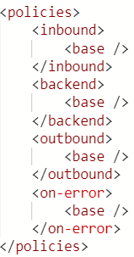
Policy
Azure API Management policy definitions are XML documents that consist of a series of statements, each of which represents a policy and its parameters. The XML document is divided into the following sections:
inbound: The policies in this section are applied to each incoming API request.
backend: The policies in this section are applied before each incoming API request is routed to its backend service.
outbound: The policies in this section are applied to each outgoing API response.
on-error: The policies in this section are applied when an API request or response generates an error.
Notes:
​

Slide 10


